Slide 1
Inspirational Printmakers
Draft version to demo creative process
Could morph into a different presentation at this point
Notes:
I created my own theme from an existing theme because ....

Slide 2
Overview
Durer
Hokusai
Escher
Elizabeth Catlett
Picasso
Notes:
I chose this because or I created this theme because...

Slide 3
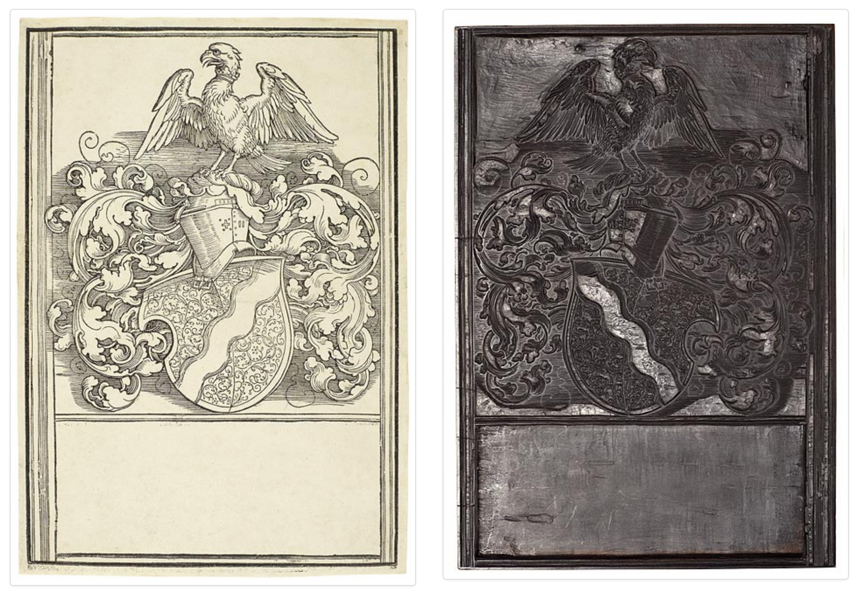
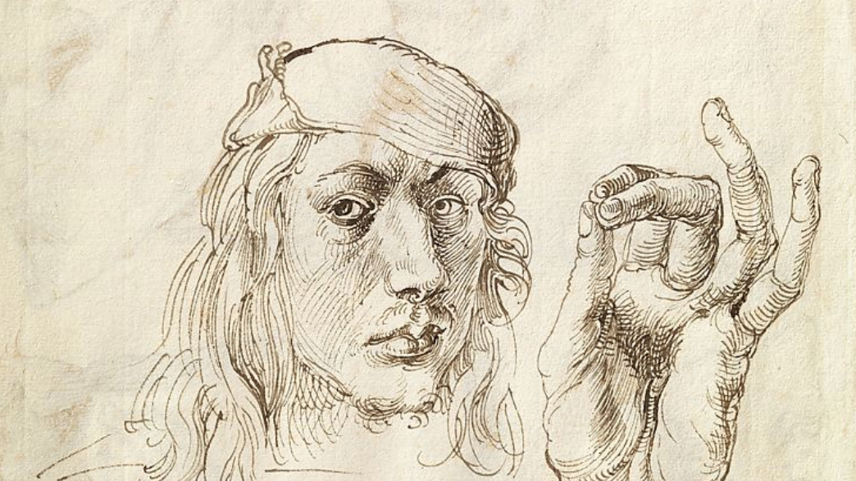
See the process in action
See Dürer at Met

Slide 4
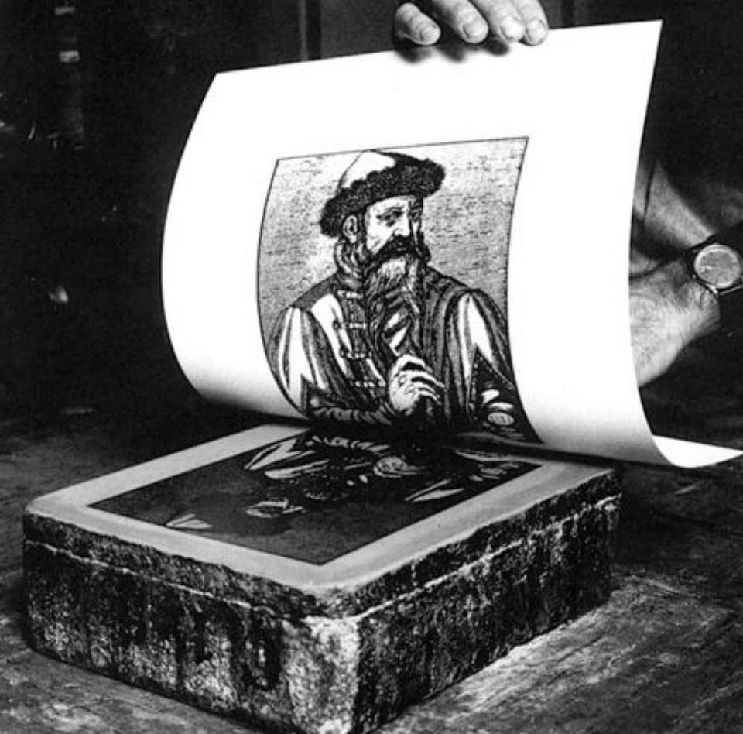
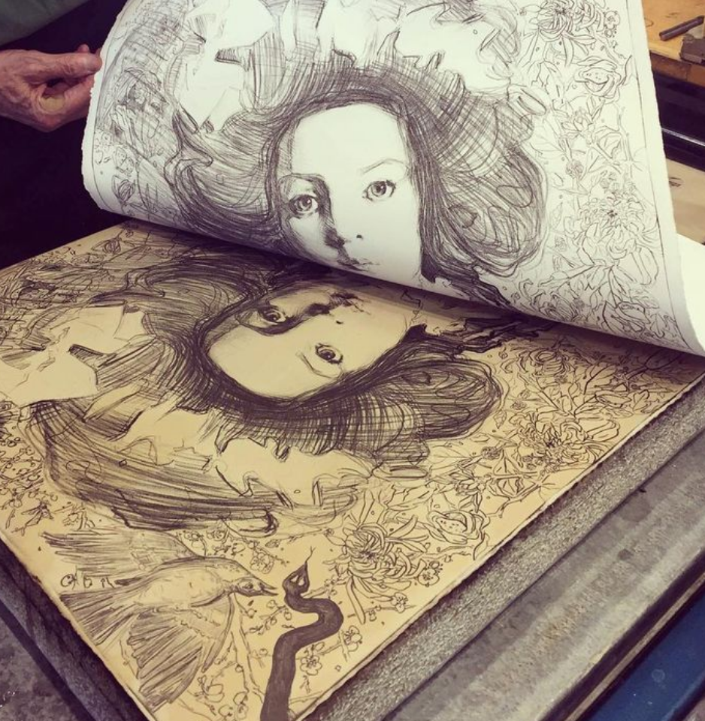
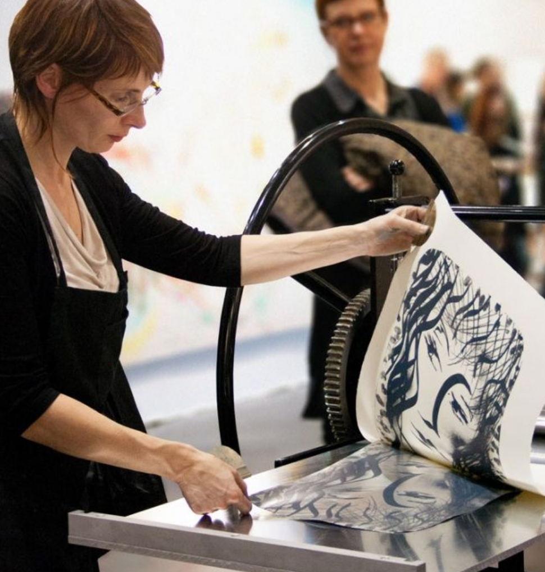

Slide 5
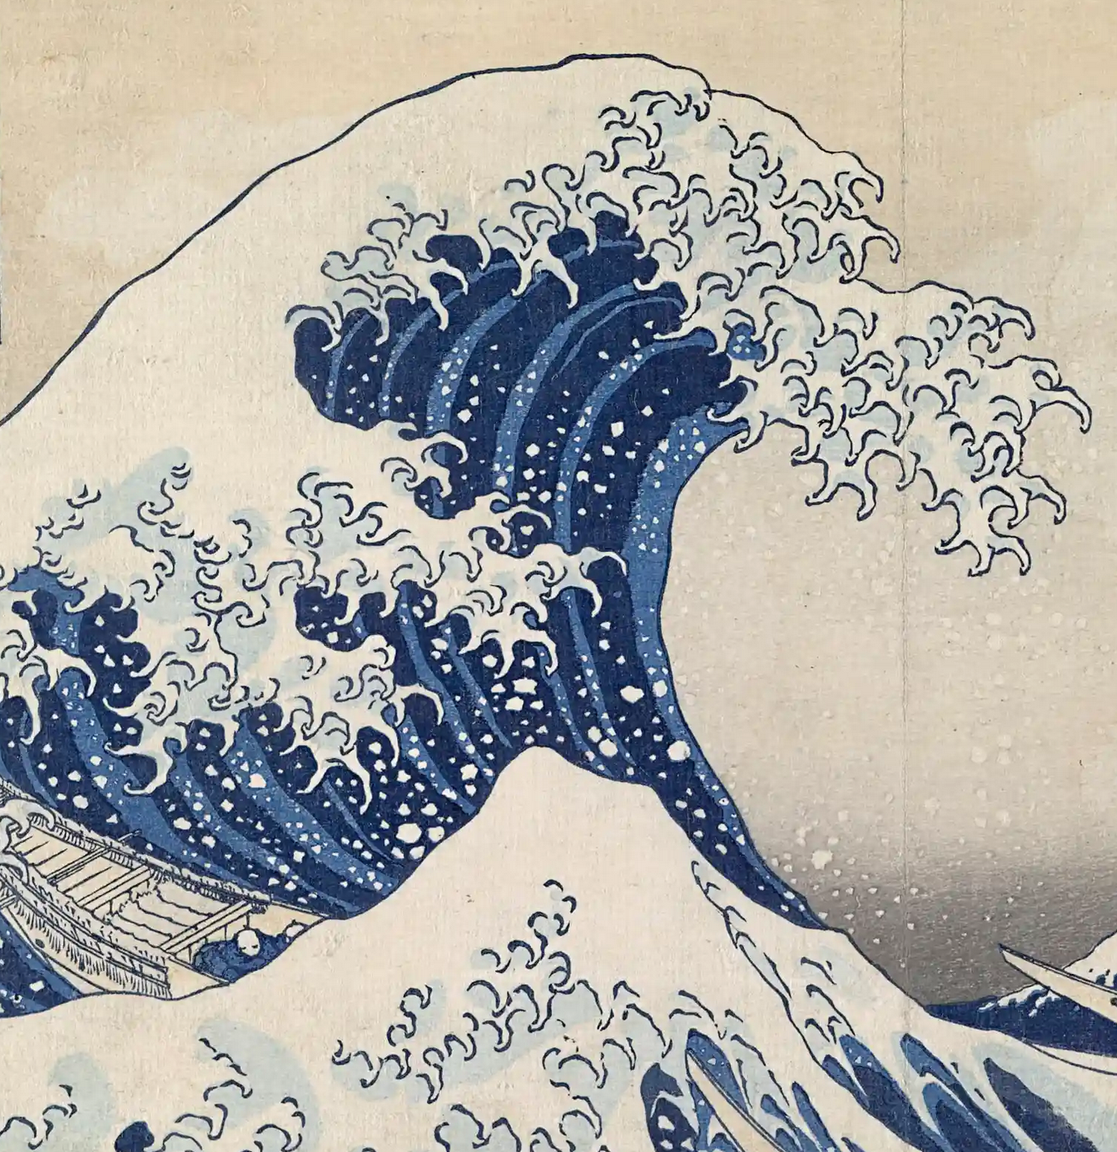
Hokusai

Slide 6
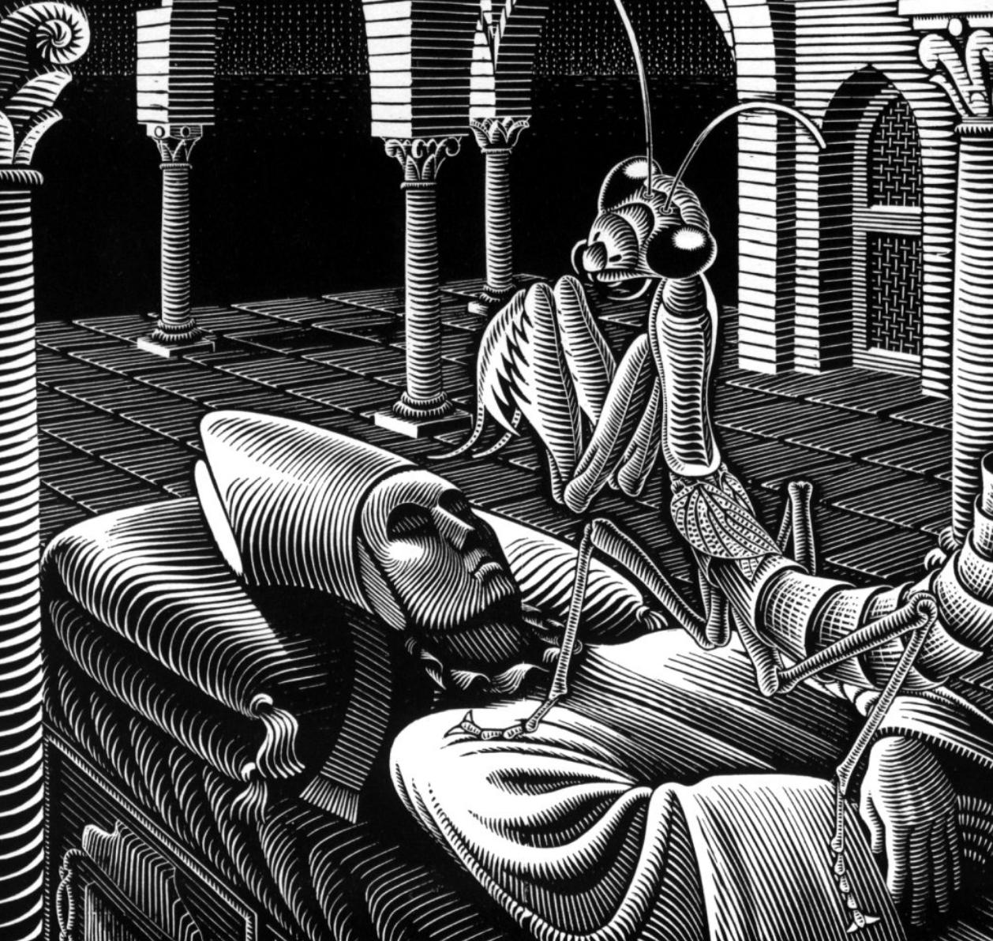

Slide 7
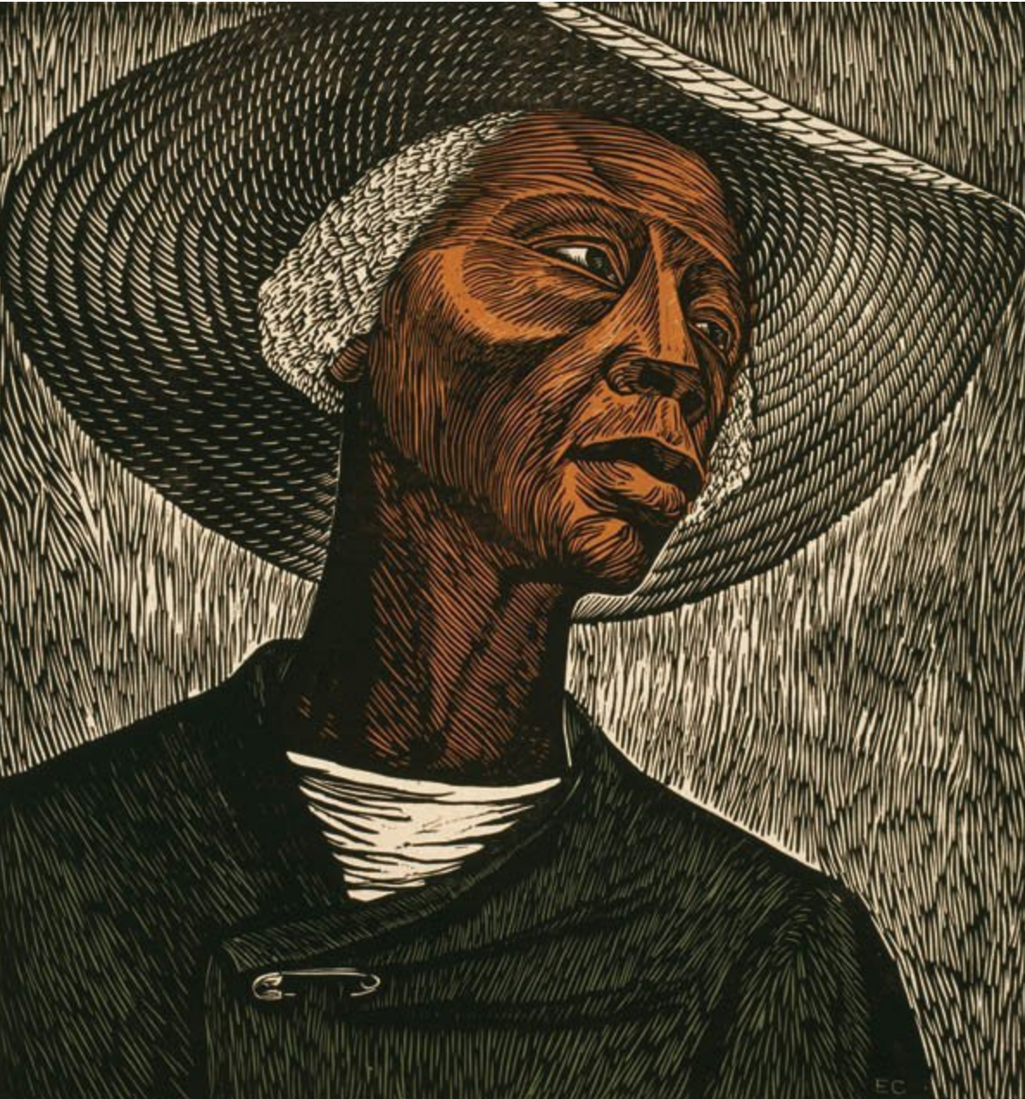

Slide 8
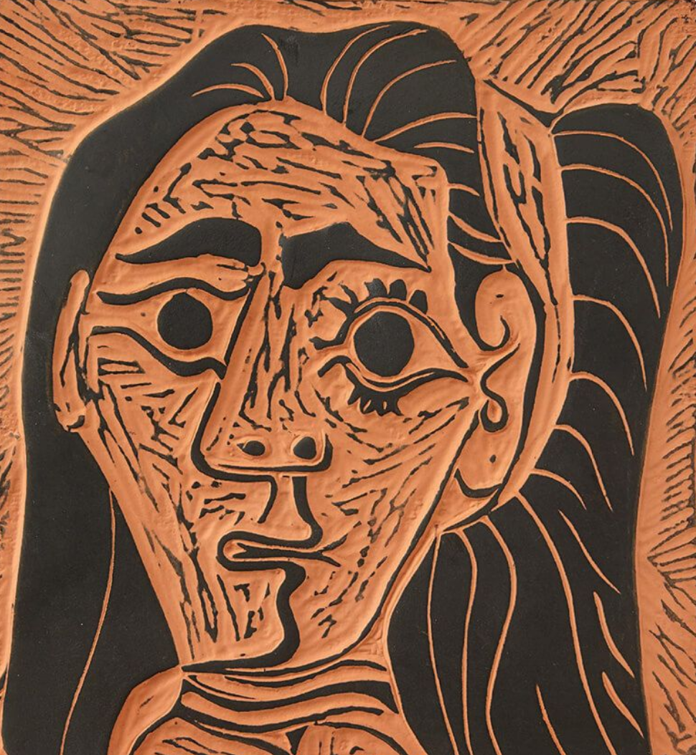

Slide 9
Summary
Durer ......
Hokusai .......
Escher .......
Elizabeth Catlett ......
Modigliani ......
Picasso ........
Notes:
I chose this because or I created this theme because...

